Slide 1
big data
David Kauchak
CS158 – Fall 2023

Slide 2
Admin
Assignment 8
Use the hand-example to test your code before coming to mentor hours
Assignment 9
Office hours on zoom today

Slide 3
Big Data
What is “big data”?
What are some sources of big data?
What are the challenges of dealing with big data?
What are some of the tools you’ve heard of?

Slide 4
Big data and ML
Why talk about it in a course like this?

Slide 5

Machine Learning is…
Machine learning is about predicting the future based on the past.
-- Hal Daume III

Slide 6
Machine Learning is…
Machine learning is about predicting the future based on the past.
-- Hal Daume III
If the “past” has lots of data, then we need tools to process it!

Slide 7
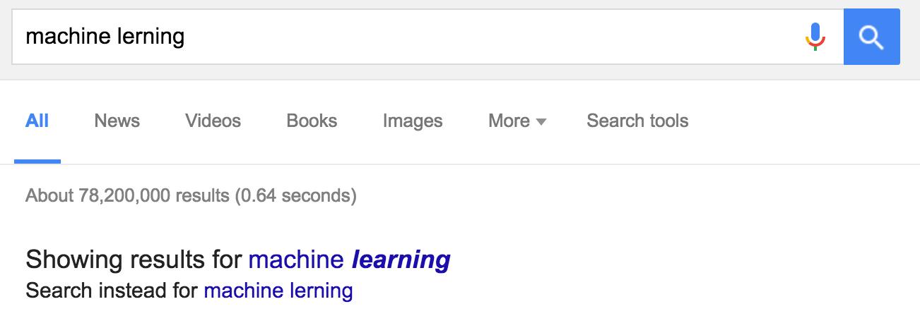
Big data and ML
Why talk about it in a course like this?
Many “machine learning” problems become much easier when you have lots of data

Slide 8

Big data and ML
How would you do it?

Slide 9
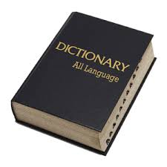
Big data and ML
How would you do it?
edit distance

Slide 10
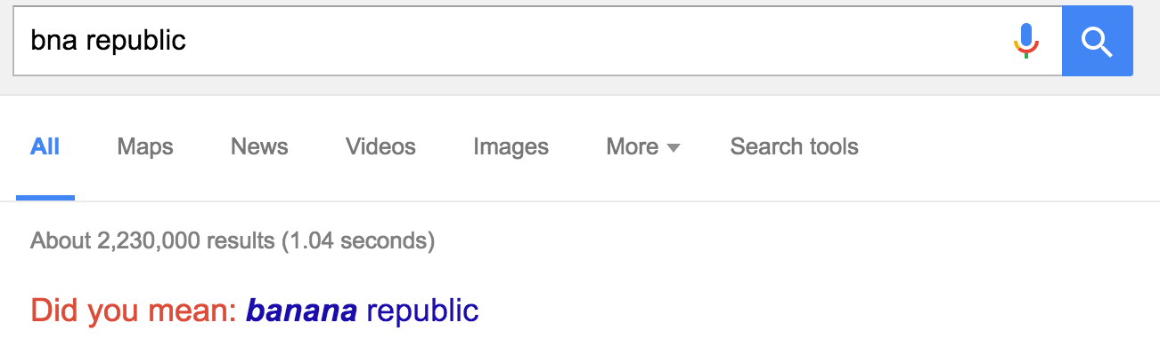
Big data and ML
How would you do it?
May not get example like this!

Slide 11
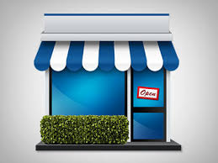
Big data and ML
How would they do it?
(small company)
May not get example like this correct!

Slide 12

Big data and ML
How would they do it?
(small company)
machine learning
model/
predictor
text corpus

Slide 13

Big data and ML
How does Google do it?
May not get example like this!

Slide 14
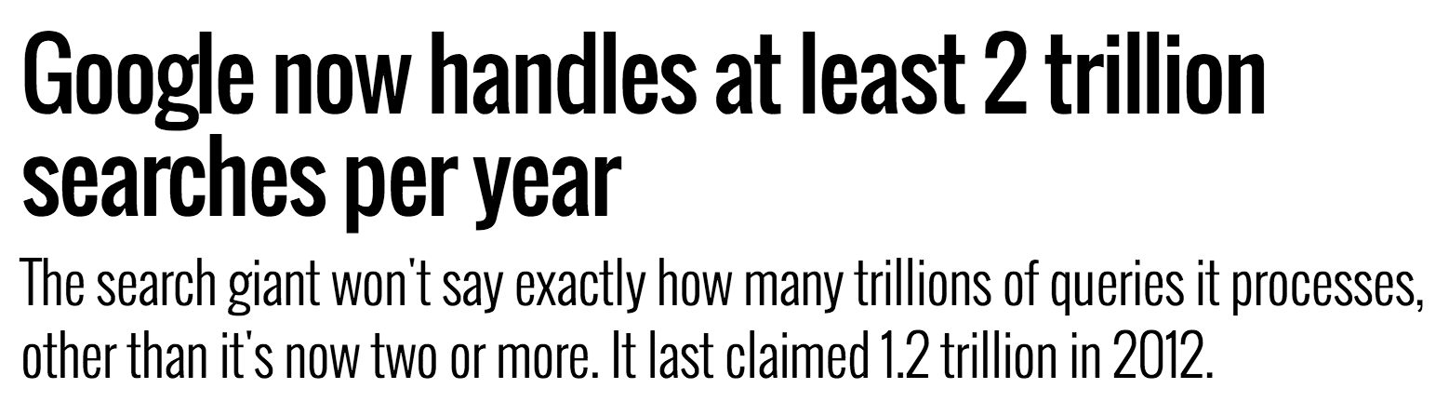
Big data and ML
http://searchengineland.com/google-now-handles-2-999-trillion-searches-per-year-250247

Slide 15
Big data and ML
Search logs
user_id time query
…
131524 t bna republic
…
131524 t+5s banana republic
…
Many problems get easy when you have lots of data!

Slide 16
Big data and ML
Many problems get easy when you have lots of data!
Challenge: processing all this data in an efficient way

Slide 17
Big data and ML
For this class, we’ll look at Hadoop
It is one framework for processing massive amounts of data
Many frameworks exist, but most share a similar property: have to think about how to parallelize/distribute processing

